Slide 1
Spreadsheet Design and Auditing

Slide 2
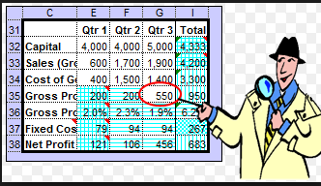
Spreadsheet Architecture
Design Considerations:
Because a spreadsheet can be designed iteratively, there is a tendency toward spreadsheet processing sprawl.
Over time, spreadsheets can suffer from numerous changes and patches to fix anomalies.
New patches can break existing processing. The entire spreadsheet should be checked to ensure each processing cell has valid results.

Slide 3
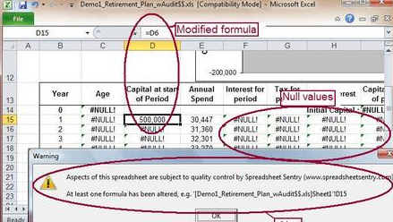
Problems can occur in Multiple Spreadsheet areas
Processing Error(s)
Can be one error or multiple errors
Can be of little importance or material impact
Errors can occur in both areas at the same time.

Slide 4
Data Input Errors:
Human error in manual data input --Number 1 error, data where a formula should be
Bad formula – logic issue or range issue
Linked data (from other spreadsheet(s))not correct
Systemic data does not match expected data input
Unexpected values not caught by input validation
Data validation could be weak or non-existent

Slide 5
Bad Data Input (Garbage In – Garbage Out)

Slide 6
Processing Errors:
Processing in spreadsheet not understood
Logic errors in calculations (doesn’t satisfy business requirement)
Incorrectly linked values (from copying / pasting)
Cells designated only for processing are inadvertently changed through input (if not properly locked down)

Slide 7
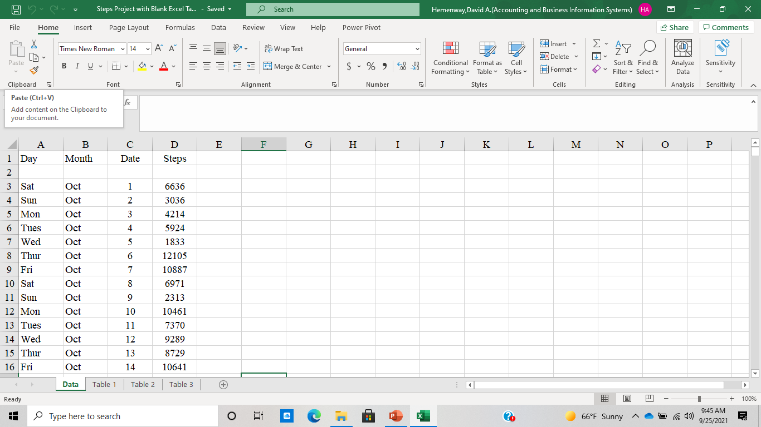
Basic Spreadsheet Design

Slide 8

Tools to Use to Audit Spreadsheets
Look at the data and verify it is good.
Reveal formulas – look for data where there should be formulas
Double click on formulas to reveal data inputs and ranges
Try the formulas to ensure that they are logically correct
Try to process the sheet as it is used

Slide 9
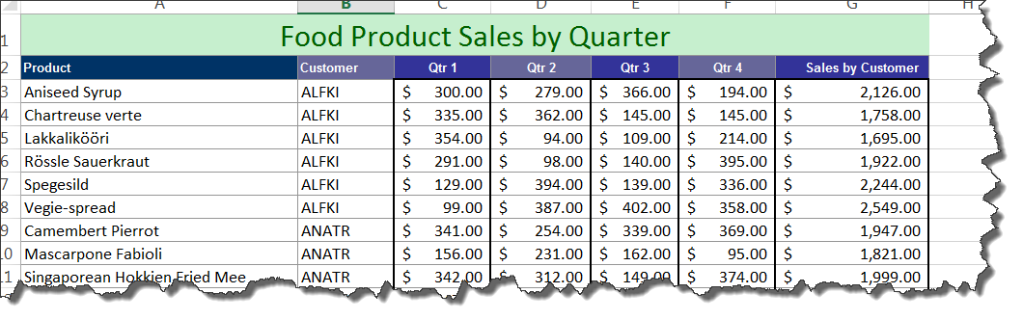
Bad Spreadsheet – Find 8 Problems
Download Bad Spreadsheet and find all the hidden problems. Use the tools above and your own curiosity. Everything is not as it seems.

Slide 10
When is the best time to find spreadsheet errors?

